Slide 1
Part II
Elementary Statistical Methods
Descriptive Statistics

Slide 2
Elementary Statistical Methods
Chapter 3
Data Description
(Numerical Summary of Data)
Slides are made by
Tamer Oraby
UTRGV

Slide 3
Outline:
Numerical summary of variables: qualitative and quantitative.
Proportion, mean, median, mode, midrange, variance, standard deviation, coefficient of variation, quartiles, outliers, boxplot.

Slide 4
Population
Sample
Sample size is
denoted by n
Population size is
denoted by N
Statistic: numerical
summary of sample.
We usually use Latin letters to denote
statistics, like
$$\overline{x}, s, p$$
Parameter: numerical
summary of population.
We usually use Greek letters to denote parameters, like
$$μ, σ, ρ$$

Slide 5
Qualitative variables

Slide 6
The only numerical summary of qualitative variables is the proportion.
Population proportion is $ρ$. Sample proportion is $p$.
Example :
Gender of 10 students randomly selected from the class was recorded as:
F, F, M, M, M, F, F, F, M, F
Thus, the proportion of female students in the sample is
$p=\frac{6}{10}=0.6$.
Example:
If there are 300 infected people in a population of 1000
individuals then the proportion of infected people in the population is
$ρ=\frac{300}{1000}=0.3$. (also called prevalence)

Slide 7
Quantitative variables

Slide 8
Mean
Median
Mode
Midrange
Numerical summary of quantitative variables
Measures of center
or central tendency
“Typical value of data”
Measures of spread /dispersion/variation
Measures of position
Range
Variance
Standard deviation
Coefficient of variation
IQR
Percentiles
Quartiles
Boxplot
Outliers

Slide 9
3.1 Measures of central tendency
1. Mean (arithmetic mean)

Slide 10
If the population values of the variable X are $x_{1},x_{2},…, x_{N}$ then
$$μ=\frac{x_{1}+x_{2}+…+x_{N}}{N}=\frac{\sum_{i=1}^{N}{x_{i}}}{N}$$
Population mean
If the sample values of the variable X are $x_{1},x_{2},…, x_{n}$then
$$\overline{x}=\frac{x_{1}+x_{2}+…+x_{n}}{n}=\frac{\sum_{i=1}^{n}{x_{i}}}{n}$$
Sample mean
x-bar

Slide 11
Example :
Ages of five people selected randomly from a population are given by 3, 8, 7, 5, 5 years, then the sample mean is
Example :
Ages of six people selected randomly from a population are given by 3, 8, 7, 5, 5, 70 years, then the sample mean is
Try it
The mean is sensitive to outliers

Slide 12
Physical interpretation of the Mean
In the first example,
3
4
5
6
7
8
The mean is the point of balance of the data points.

Slide 13
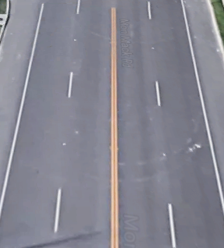
2. Median
The middle number (in a sorted list of numbers)
Steps to find the median:
Step 1: Ordering
Sort/Order the data set X₁, X₂, …, X_{n}
increasingly.
Step 2: finding position
If n is odd (1, 3, 5,…)
If n is even (2, 4, 6,…)
Step 3: Finding the median

Slide 14
Example :
Ages of five people selected randomly from a population are given by 3, 8, 7, 5, 5 years. Find the median.
Step 1:
Order the data set 3, 5, 5, 7, 8
Step 2:
Since n=5 is an odd number
Step 3:

Slide 15
Example :
Ages of six people selected randomly from a population are given by 3, 8, 7, 5, 5, 70 years. Find the median.
Step 1:
Order the data set 3, 5, 5, 7, 8, 70
M=6
Step 2:
Since n=6 is an even number
Step 3:
Try it
The median is resistant to outliers.

Slide 16
3. Mode
The value that appears most often in the sample (the most frequent value).
Example :
Ages of five people selected randomly from a population are given by 3, 8, 7, 5, 5 years. Find the mode.
Mode = 5
If there is no repetition then there is no mode.

Slide 17
4. Midrange
The midpoint between (average of) the highest (maximum or max) value H, and the lowest (minimum or min) value L.
$$\text{Mid}\text{range} \text{M}\text{R}=\frac{L+H}{2}$$
Example :
Ages of five people drawn from a population are given by
3, 8, 7, 5, 5 years. Find the midrange.
$$\text{Mid}\text{range} \text{M}\text{R}=\frac{3+8}{2}=5.5 years$$

Slide 18
3.2 Measures of dispersion
Dispersion is the degree to which the data are spread out.
1. Range
The difference between the highest (maximum or max) and the lowest (minimum or min) values.
Example :
Ages of five people drawn from a population are given by
3, 8, 7, 5, 5 years. Find the range.

Slide 19
Example :
Ages of six people drawn from a population are given by 3, 8, 7, 5, 5, 70 years. Find the range.
The range doesn’t take into consideration the number of points in between the lowest and the highest value.

Slide 20
2. Deviation from the mean
Example :
Ages of five people drawn from a population are given by 3, 8, 7, 5, 5 years. Find the total deviation from the mean.
- 2.6
- 0.6
2.4
1.4
- 0.6
3
4
5
6
7
8
Always and not just in this example
Means sum; it is an uppercase Greek letter Sigma

Slide 21
3. Variance
Based on total of squared deviations in stead of the total deviations which is 0.
Population variance :
$$σ^{2}=\frac{{{(x}_{1}−μ)}^{2}+{{(x}_{2}−μ)}^{2}+…+{{(x}_{N}−μ)}^{2}}{N}$$
Sigma - squared
(unit)²
Sample variance :
$$s^{2}=\frac{{{(x}_{1}−\overline{x})}^{2}+{{(x}_{2}−\overline{x})}^{2}+…+{{(x}_{n}−\overline{x})}^{2}}{n−1}$$
s- squared
(unit)²
4. Standard deviation
Population standard deviation :
(same unit as of data)
Sample standard deviation :
(same unit as of data)

Slide 22
Example :
Ages of five people drawn from a population are given by 3, 8, 7, 5, 5 years. Find the standard deviation.
x | Deviation | Squared Deviation
3 | 3 - 5.6 = -2.6 | (-2.6)²
5 | 5 - 5.6 = -0.6 | (-0.6)²
5 | 5 - 5.6 = -0.6 | (-0.6)²
7 | 7 - 5.6 = 1.4 | (1.4)²
8 | 8 - 5.6 = 2.4 | (2.4)²
Total | 0 | 15.2

Slide 23
The larger the value of $s, s^{2}, σ, or σ^{2}$ is, the more variability
is there in the data about its mean, or the more the data is dispersed
about its mean.
Example :
If two samples have s₁ = 2 and s₂ = 30 of the same type of variable then the second sample is more varied/dispersed about its mean.
But, how can we compare between two different variables (with different units)?

Slide 24
4. Coefficient of Variation (CV).
Population CV:
$$CV=\frac{σ}{μ} 100\%$$
unitless
Sample CV:
$$CV=\frac{s}{\overline{x}} 100\%$$
unitless
Example :
Ages of five people drawn from a population are given by 3, 8, 7, 5, 5 years. Find the coefficient of variation.
$$CV=\frac{1.95}{5.6} 100\%=34.8\%$$

Slide 25
Example :
Ages and weights of five people drawn from a population are given by
3, 8, 7, 5, 5 years and 70, 85, 90, 60, 70 pounds. Compare the variability in age to weights.
$$CV of age=\frac{1.95}{5.6} 100\%=34.8\%$$
$$CV of weight=\frac{12.25}{75} 100\%=16.3\%$$
There is more variability in age than in weight.

Slide 26
Using Calculator TI-84 Plus
Data entry
Press [STAT] key
Choose [Edit…]
Enter x into list 1 [L1]
Statistics calculations
Press [STAT] key
Choose [CALC]
Choose option 1: [1-Var Stats]
List: L1
FreqList: leave empty
On some calculators you do
1-Var Stats L1

Slide 27
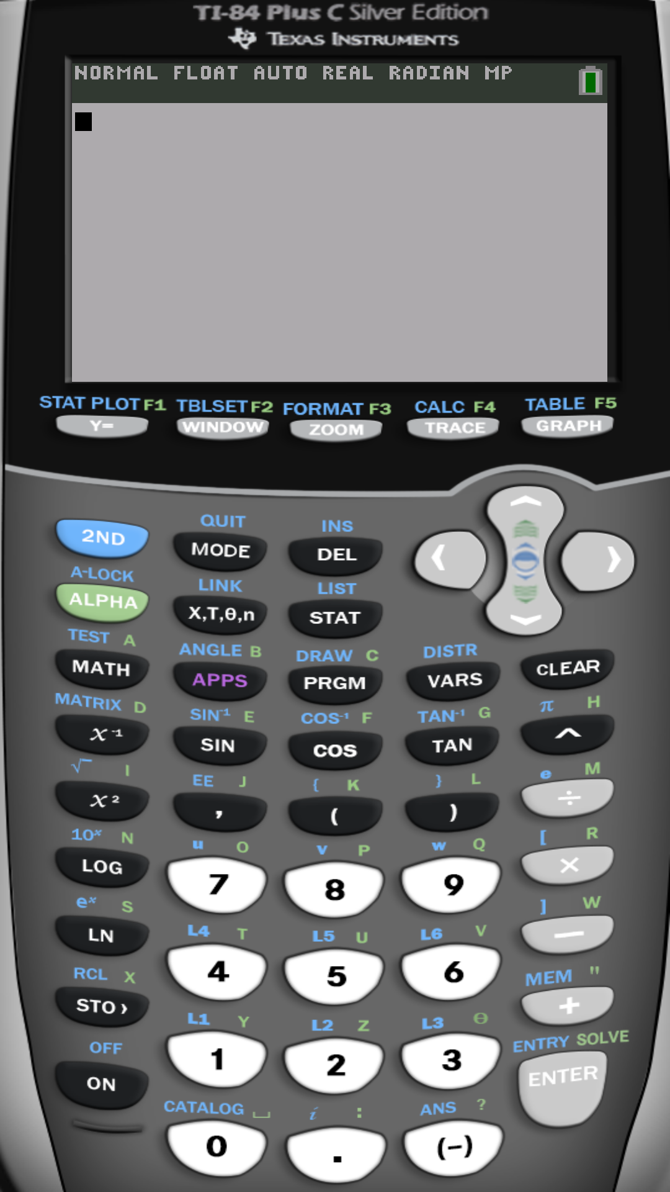
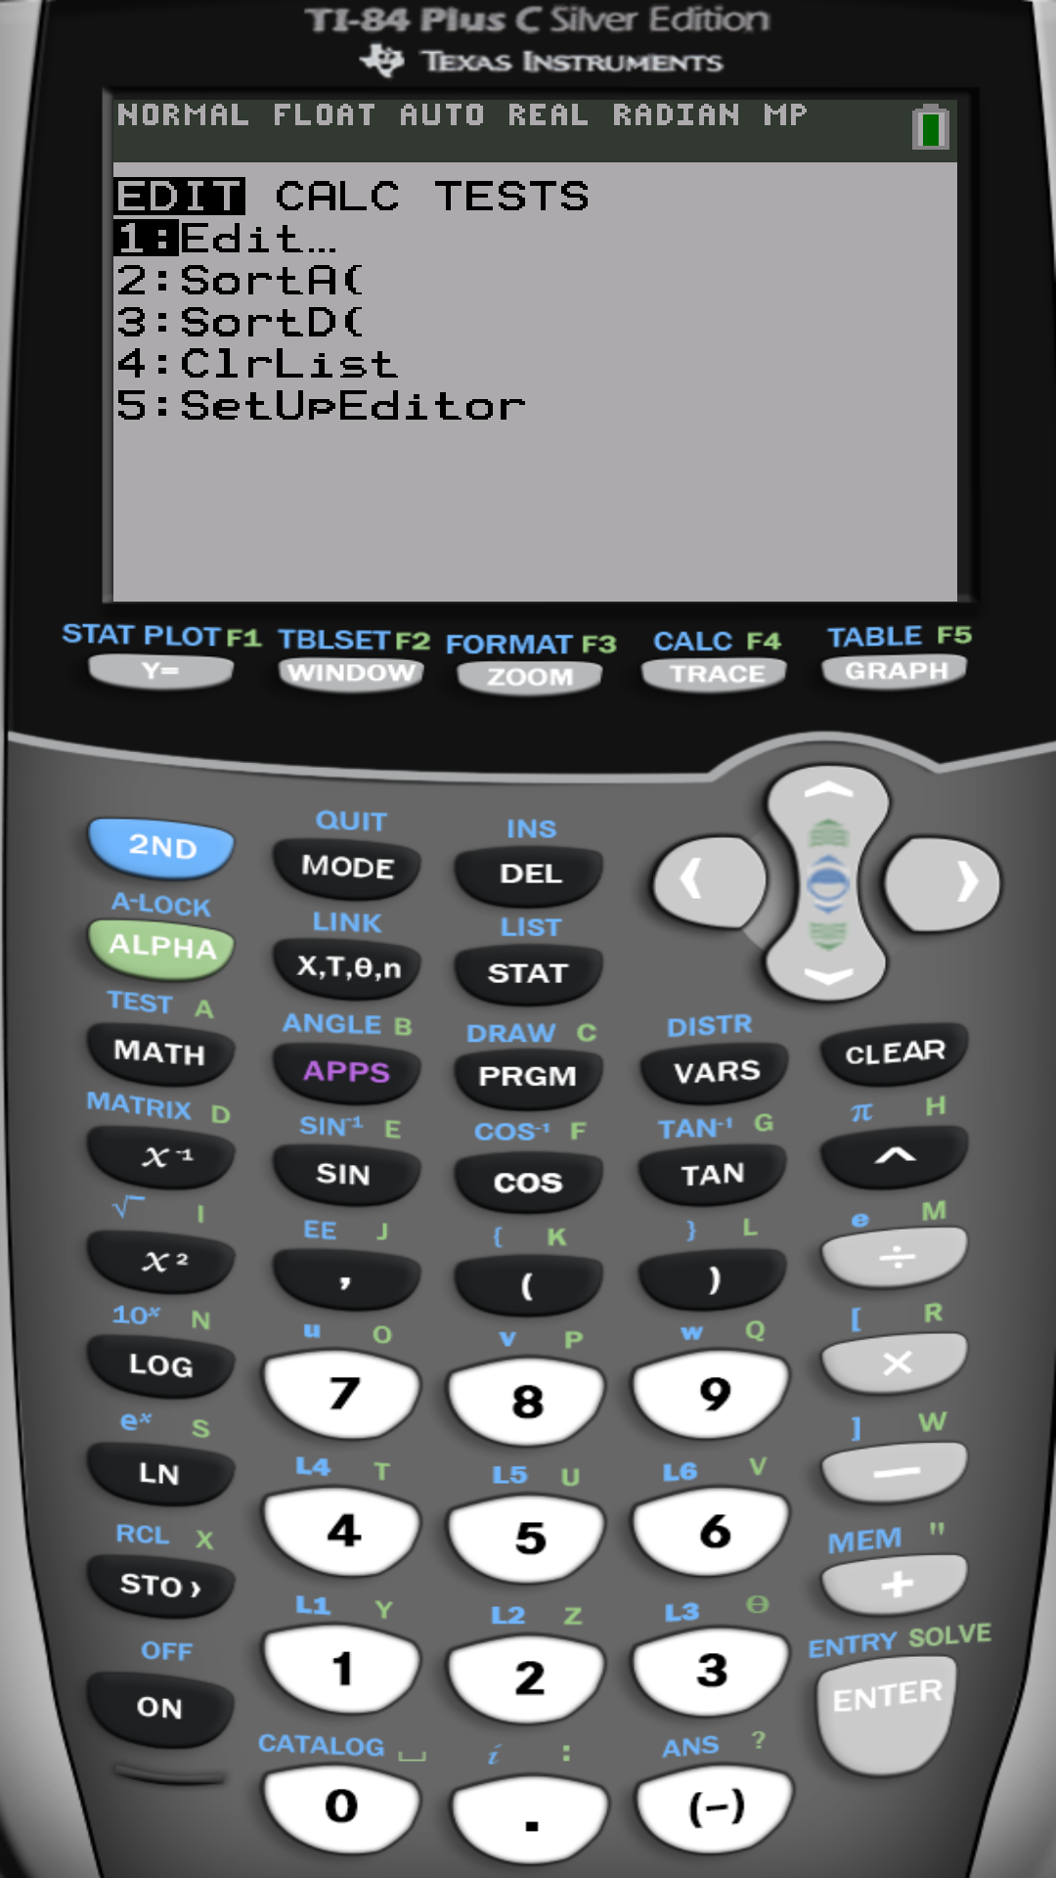

Slide 28
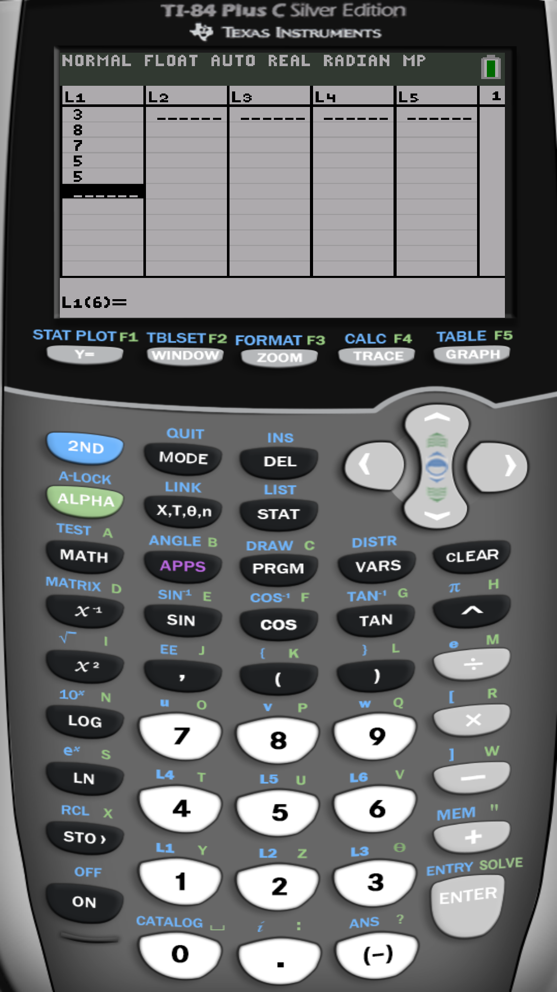
For the same sample: 3, 8, 7, 5, 5

Slide 29
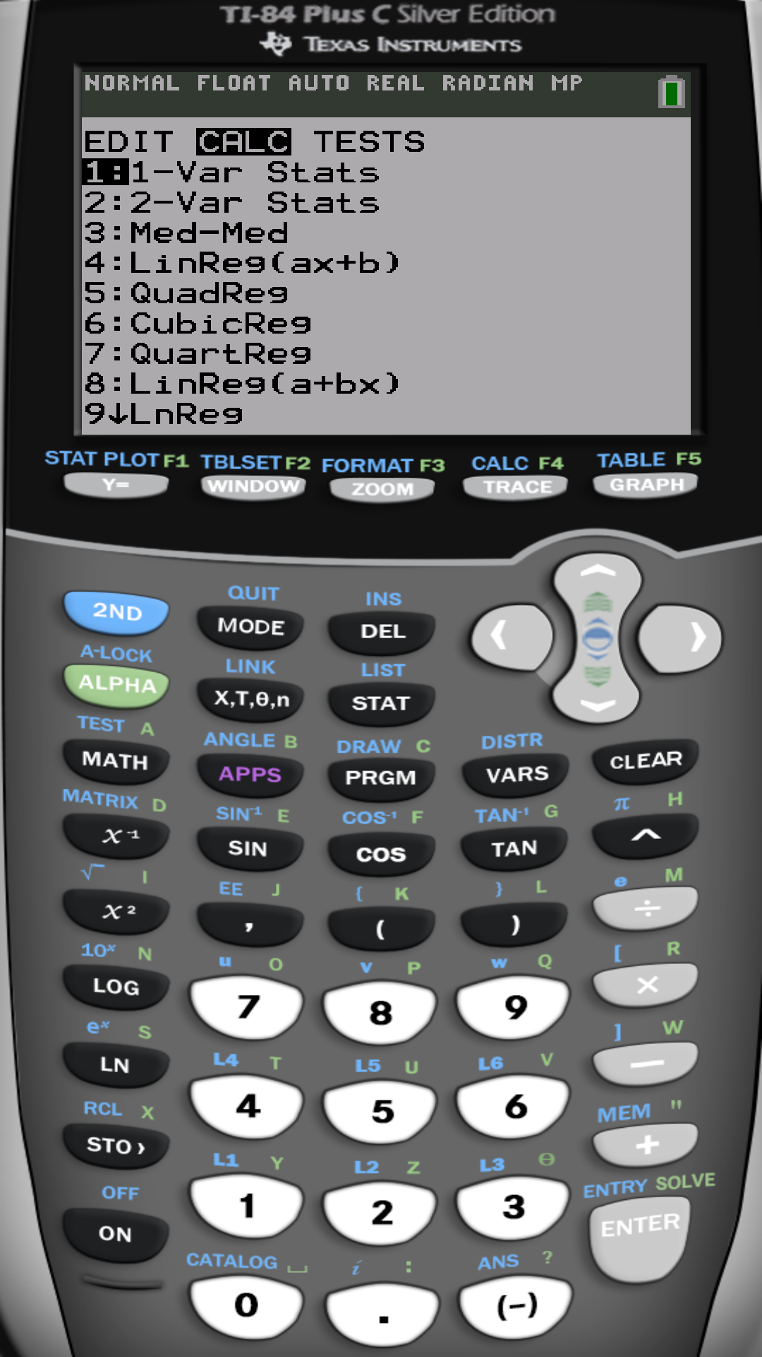
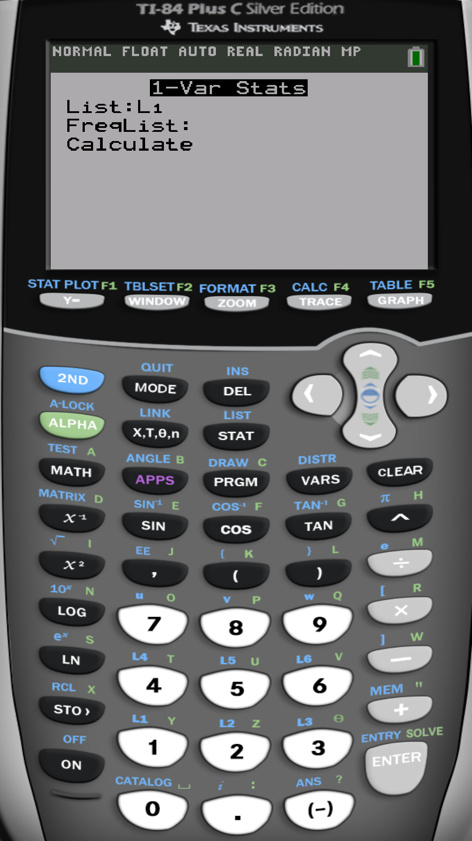

Slide 30
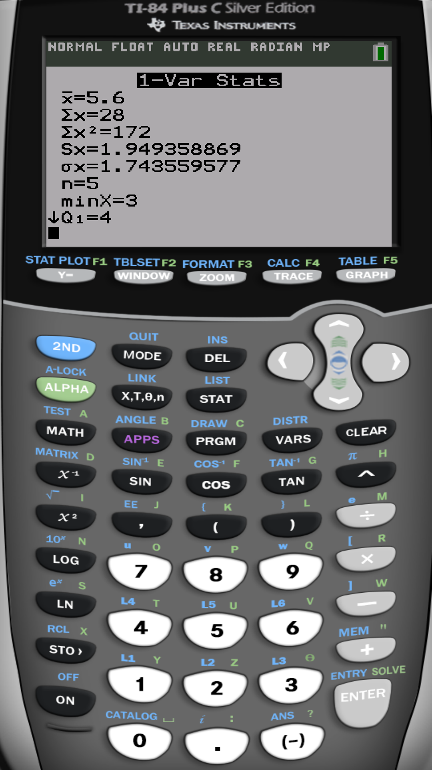
The sample mean is
The sample standard deviation is
The sample variance is

Slide 31
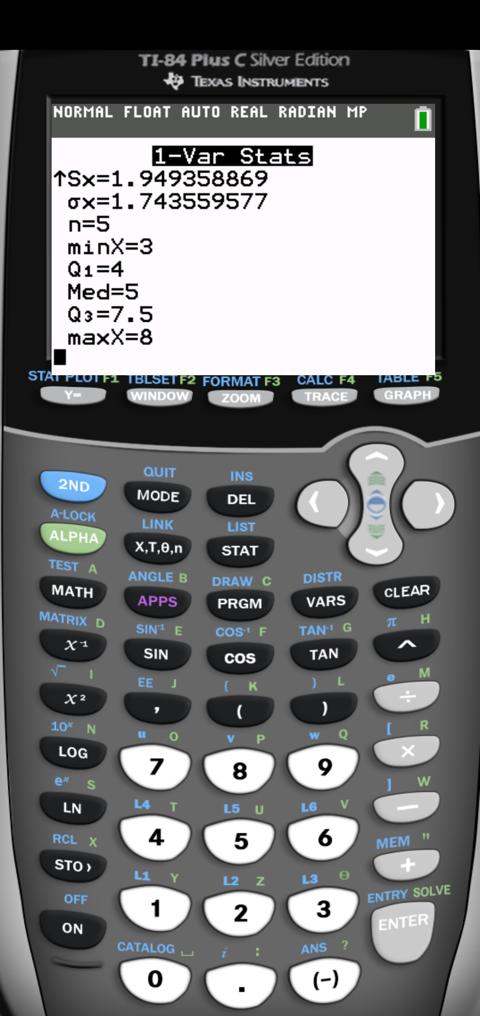
The median is
$$M=5$$

Slide 32
Example 1:
Find the mean and standard deviation of the population
4, 3, 2, 6, 4, 3
Note that the Median could be found to be M = 3.5
Example 2:
Find the mean and standard deviation of the sample
20, 30, 34, 28, 19, 28
Note that the Median could be found to be M = 28

Slide 33
What about data point with weights or frequency distributions (discrete/continuous)?

Slide 34
Weighted mean and variance.
How can we find the summaries
if the data is grouped in a frequency table?
Where:
$L$ is the number of classes
$x_{i}$ are the discrete variable values or
the continuous variable midpoints
$f_{i}$ are the frequencies
Sample mean
Sample variance

Slide 35
Measures of center and dispersion for grouped data
Consider a sample of 45 insects
Length of insect (cm) | Frequency $f_{i}$ | Midpoints $x_{i}$ | $$f_{i}∗x_{i}$$ | $$f_{i}∗{(x_{i}−\overline{x})}^{2}$$
0 - 0.9 | 10 | $$\frac{0+1}{2}=.5$$ | 5 | 19.6
1 – 1.9 | 12 | $$\frac{1+2}{2}=1.5$$ | 18 | 1.92
2 - 2.9 | 18 | $$\frac{2+3}{2}=2.5$$ | 45 | 6.48
3 – 3.9 | 5 | $$\frac{3+4}{2}=3.5$$ | 17.5 | 12.8
Total | 45 |  | 85.5 | 40.8
Number of classes L=4

Slide 36
Midpoints x | f
.5 | 10
1.5 | 12
2.5 | 18
3.5 | 5
.5
1.5
2.5
3.5
0
1
2
3
4

Slide 37
Using Calculator TI-84 Plus
Data entry
Press [STAT] key
Choose [Edit…]
Enter x as discrete values or class midpoints into list 1 [L1]
and frequency f into list 2 [L2]
Statistics calculations
Press [STAT] key
Choose [CALC]
Choose option 1: [1-Var Stats]
List: L1
FreqList: L2 by pressing [2ND] [2]
On some calculators you do
1-Var Stats L1 , L2

Slide 39
For the same example:
x | f
.5 | 10
1.5 | 12
2.5 | 18
3.5 | 5

Slide 41
The sample mean is
The sample standard deviation is
The sample variance is

Slide 42
The median is
$$M=2.5$$

Slide 43
3.4 Measures of position and outliers
Measures of position describe the relative position of a certain data value within the entire set of data.
Median
1st quartile
3rd quartile
L
Q₁
Q₂= M
Q₃
H
25%
75%
50%
50%
75%
25%
L ,Q₁ ,Q₂ ,Q₃, H
Five number summary is made up from
L , Q₁ , Q₂ , Q₃ , H
The inter-quartile range IQR = Q₃ – Q₁

Slide 45
Example :
Ages of five people drawn from a population are given by 3, 8, 7, 5, 5 years. Find five number summary.
Five number summary are 3, 4, 5, 7.5, 8
Example :
Ages of six people drawn from a population are given by 3, 8, 7, 5, 5, 70 years. Find five number summary.
Five number summary are 3, 5, 6, 8, 70

Slide 46
Boxplot
The five number summary can be used to create a graph called Boxplot
L
Q₁
M=Q₂
Q₃
H
Q₃
Q₁
L
H
M=Q₂
The inter-quartile range IQR = Q₃ – Q₁

Slide 47
Shapes of distribution and boxplot
Left skewed
Symmetric
Right skewed

Slide 48
How to detect potential/possible/suspected outliers
(I call them Zombies)
Lower fence:
Upper fence:
LF = Q₁ – 1.5 * IQR
UF = Q₃ + 1.5 * IQR
LF
Q₁
Q₂
Q₃
UF
Observations smaller
than LF are suspected outliers
Observations greater
than UF are suspected outliers

Slide 49
Example :
Fraud Detection As part of “ its customers first” program, a cellular phone company monitors monthly phone usage. The program identifies unusual use and alerts the customer that their phone may have been used by another person. The following data in this program for the past 20 months.
346 | 345 | 489 | 358 | 471
442 | 466 | 505 | 466 | 372
442 | 461 | 515 | 549 | 437
480 | 490 | 429 | 470 | 516
Find the mean and standard deviation with and without the outliers. Find the five number summary along the way.
Before removing the outliers
Five number summary

Slide 50
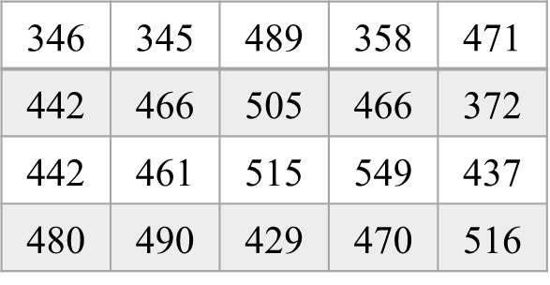
The observations 346 and 345 are suspected outliers.
Hence, after removing those two outliers,
$$\overline{x}=464.33$$
$$s=47.58$$

Slide 51
Example :
Five number summary

Slide 52
The set of suspected outliers is given by
115, 1000

Slide 53
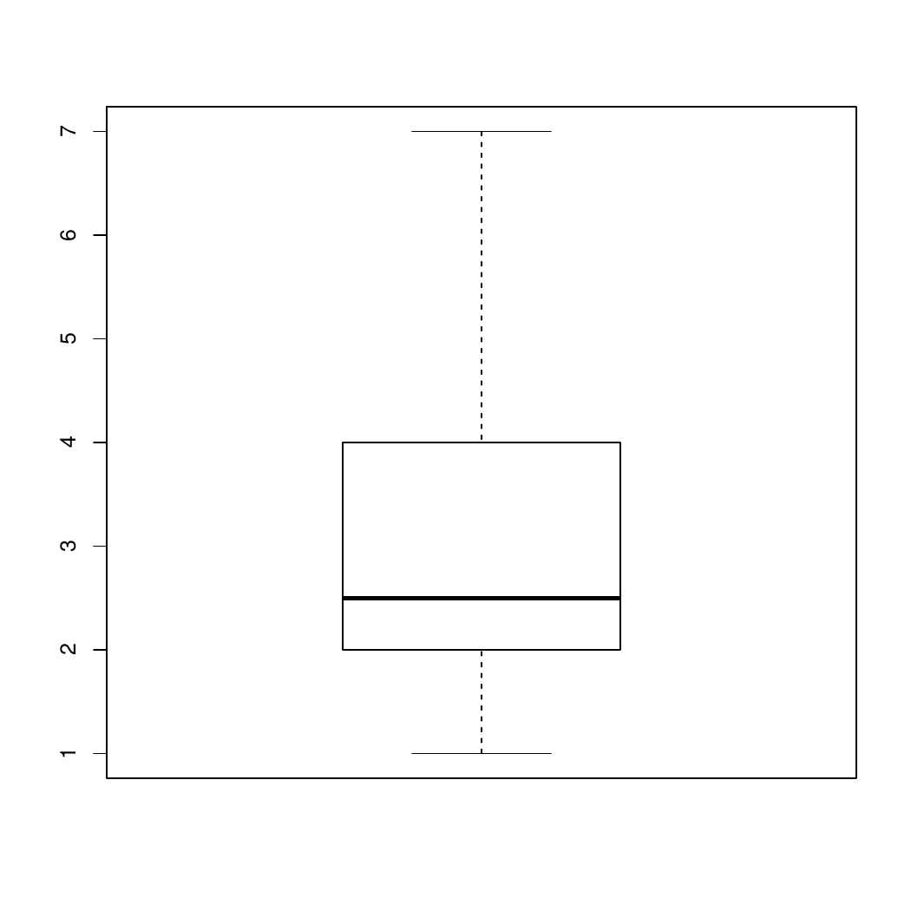
Example :
Using the following boxplot, find the five number summary and the interquartile range.
The five number summary
are 1, 2, 2.5, 4, 7
and the interquartile range is
IQR=4-2=2

Slide 54
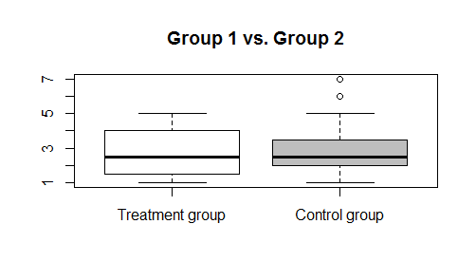
Example :
Using the following side-by-side boxplots, visually inspect the difference between the treatment group and the control group.
(Only discussion.)

Slide 55
Z-Score (standardization)

Slide 56
Z- score represents the distance that the data value is from the mean in terms of the number of standard deviations (sd) and it’s unitless.
Z-score
Population
Sample

Slide 57
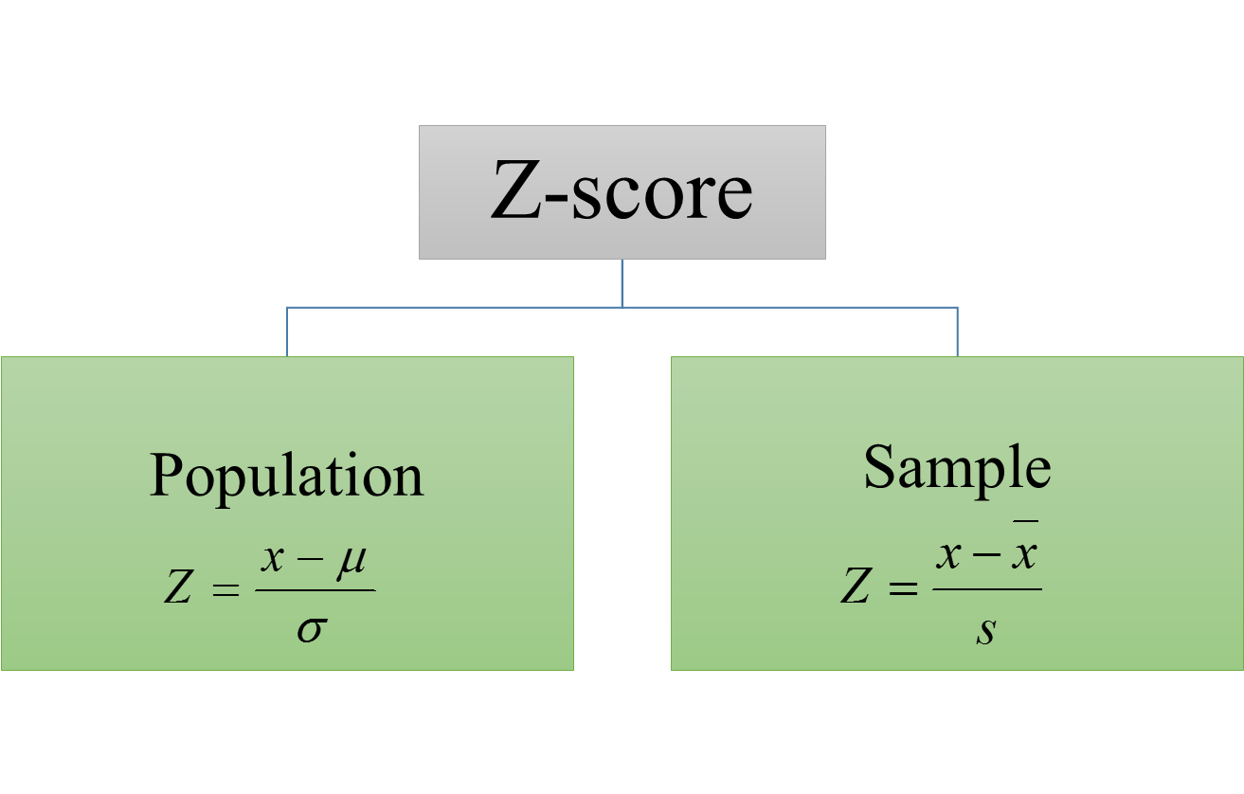
So the Z- score is the amount of standard deviations (sd) the observation $x$ is below or above the mean.
$$x=Z∗σ+μ$$
Example 1: A Z-score Z=2 means that $x$ is 2 standard deviations above the mean.
Example 2: A Z-score Z= -2 means that $x$ is 2 standard deviations below the mean.

Slide 58
Example :
If a student got 18/20 in Biology, 16/20 in Statistics and 170/200 in Chemistry. Where
Biology grades is 0.5 sd above the mean
Statistics grade is 1 sd above the mean
Chemistry grade is 1 sd below the mean
The student did best in statistics followed by biology.

Slide 59
Example :
TW is better than JA

Slide 60
Using the statistical software R
R is a free professional statistical software
Download and install for free from
https://www.r-project.org/
Free on-line R compiler
http://rextester.com/l/r_online_compiler

Slide 61
Example: Find numerical summaries of the variable 'number of people' and plot a boxplot.
# Enter the variable into R
numberofpeople=c(2,5,2,1,1,2,3,4,1,4,4,2,1,4,3,3,7,1,2,2,3,4,2,2,5,2,5,1,3,2,5,2,1,3,3,2,2,3,3,6)
# To find the mean
mean(numberofpeople)
# To find the median
median(numberofpeople)

Slide 62
# To find the variance
var(numberofpeople)
# To find the standard deviation
sd(numberofpeople)
# To find the five number summary
fivenum(numberofpeople)
# To find the inter-quartile range
IQR(numberofpeople)
# To make the boxplot
boxplot(numberofpeople)

Slide 63
End of Chapter 3

